Slide 1
JFK Terminal 6 Local Business Marketplace
Steve Thody, Chief Executive Officer, JMP
Sade Olanipekun-Lewis, Vice President Operating & Community Partnerships, JMP
Ellen Preimesberger, Director Commercial Operations & Marketing, JMP
Hersh Parekh, Deputy Chief of Intergovernmental Affairs, PANYNJ
October 8, 2024

Slide 2
AGENDA
About JFK Millennium Partners (JMP)
JFK Terminal 6 Redevelopment Overview
Local Business Marketplace Opportunities
JMP Commitment to the T6 Local Business Marketplace
T6 Local Business Marketplace Procurement Process

Slide 3
About JFK Millennium Partners

Slide 4
JFK Millennium Partners
JFK Terminal 6 is a $4.2bn redevelopment project led by JFK Millennium Partners, a consortium consisting of:
Vantage Group, a leading developer and operator of award-winning global airports;
American Triple I, a minority-owned investor and infrastructure developer
RXR Realty, a leading New York real estate firm, and;
JetBlue, New York’s Hometown Airline.®
The Port Authority of New York and New Jersey is leading the JFK Airport Redevelopment, an $19 bn airport-wide redevelopment including Terminals 1, 4, 6 and 8.

Slide 5
JFK T6 Redevelopment Overview

Slide 6
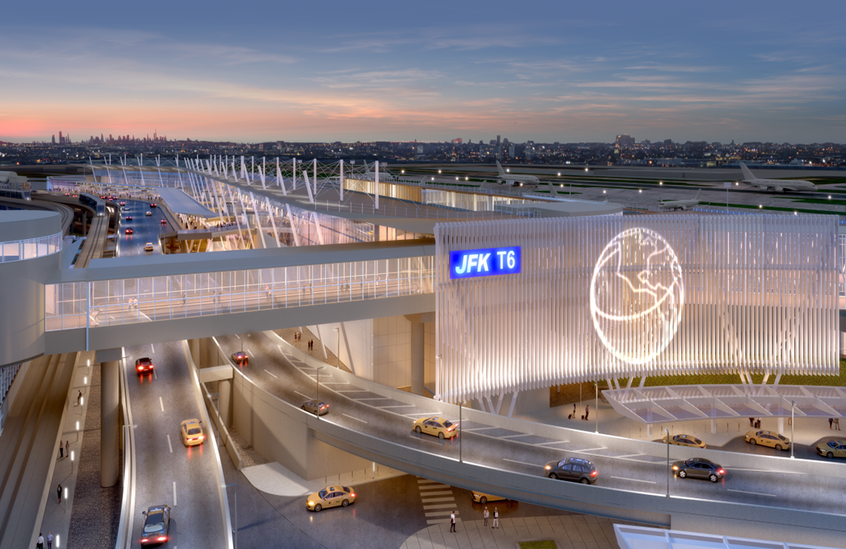
JFK Terminal 6 Redevelopment- Project Overview
JFK Terminal 6 is a redevelopment project anchoring JFK’s north side and built on the sites of the former Terminal 6 and the current Terminal 7, which will be demolished in 2026. T6 is part of a more extensive redevelopment of JFK Airport led by the Port Authority of New York and New Jersey.
Terminal 6 will feature:
1.2 million square foot terminal complex
Capacity for up to 10 gates, including nine to accommodate wide-body aircraft
Over 100,000 square feet of shopping and dining, 6 premium lounges, and recreational spaces
New roadways, utilities, aircraft aprons, and a ground transportation center
Seamless connections to JetBlue’s Terminal 5 operations
Passenger traffic (enplanements) projected to exceed 4.8M by 2030. Approximately 77% of passengers are expected to be international travelers
Development expected to result in over 4,000 direct jobs and direct payroll wages of $1.9 billion

Slide 7
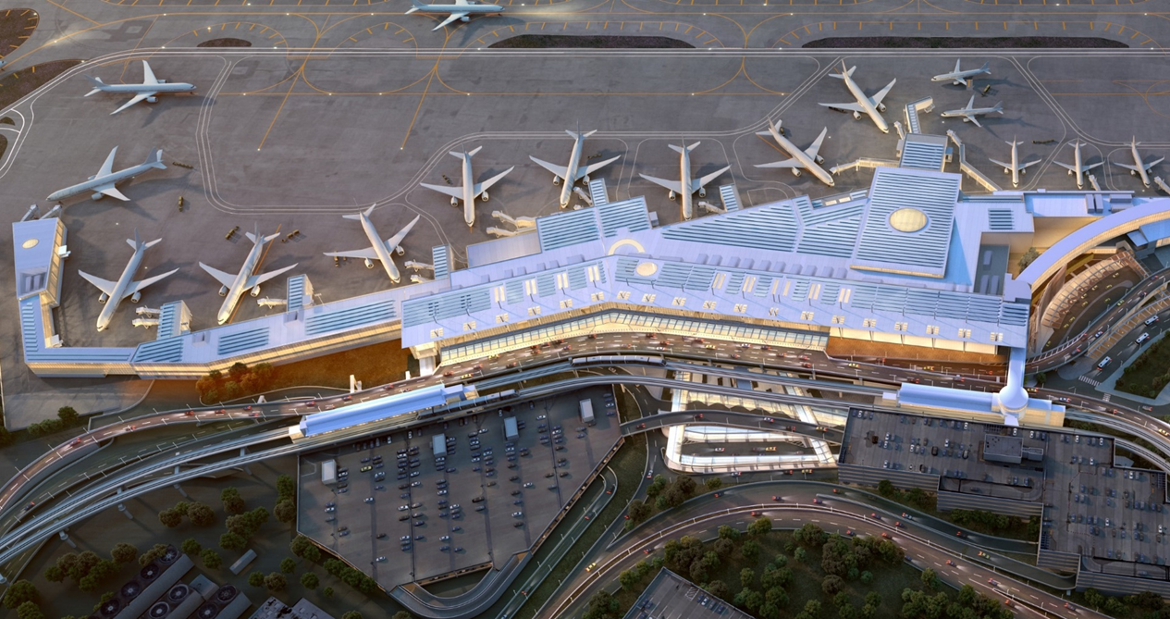
JFK Terminal 6 Development - Project Timeline
2021
Port Authority project approval
2022
Financial close
Interim operations of T7
2023/ 2024
Ground-breaking
Phase I construction of new T6
2026
Phase I completion: central hall, first 5 gates open; demolition of T7
PHASE I (2022-2026)
2026/ 2027
Phase II construction
2028
Phase II completion: additional gates open; Full terminal occupancy

Slide 8
T6 Local Business Marketplace Opportunities

Slide 9
T6 Local Business Marketplace Objectives
JMP is creating opportunities for Queens businesses & IOC graduates to step foot into the airport environment with minimized risk and strategic support
5 Retail & Grab-and-Go Opportunities
Marketplace Goals
2 kiosks and 3 in-line units
Opened in 2 phases (3 units in 2026 & 2 units in 2028).
Exclusively available to local businesses and graduates of the PANYNJ Institute of Concessions (IOC) program, with 1 unit reserved for an IOC graduate.
The Marketplace will welcome Terminal 6 passengers to the talent, diversity and vibrancy of Queens.
Businesses should enhance the passenger experience and contribute to their journey, introducing unique brands, products and delicacies that can only be discovered in Queens.
Supporting Queens and Local Entrepreneurs
Benefits to our Passengers
Our program will support entrepreneurs through every stage, from outreach and procurement through day-to-day operations & marketing to maximize their chances for success at the airport.
Surprise & delight with unexpected, unique souvenirs and keepsakes.
A Terminal that is a-part-of their NYC travel experience.

Slide 10
Eligibility Requirements and Benefits
Who Can Participate?
Business Requirements
Benefits for Businesses
PANYNJ Institute of Concessions graduates
AND/OR
Businesses with headquarters in Queens or in Tier 1 zip codes:
11405, 11411, 11412, 11413, 11414, 11416, 11417, 11418, 11419, 11420, 11421, 11422, 11423, 11428, 11429, 11430, 11432, 11433, 11434, 11435, 11436, 11451, 11691, 11692, 11693, 11694, 11695, 11697, 11559, 11598, 11096, 11516, 11557, 11003, 11580, 11581, 11582
At least 3 years of operations
High-volume capacity & infrastructure:
1,500 transactions per month
High-grossing retail experience (may include pre-packaged food)
Reduced capital investment in shop design
Marketing consultation services
Two-year deals with flexibility to extend
Exposure to the airport environment & established peer concessionaires
Possible future opportunities within the industry for supply chain, wholesale, joint venture, and/or stand-alone concession businesses

Slide 11
T6 Local Business Marketplace: Key Considerations
Hours of Operation | Concessionaires are required to open one hour before the first flight and remain open until the last flight leaves. Concessionaires may be required to remain open due to flight delays or other circumstances.
Badging and Security | All employees working in JFK must pass a security background check and comply with all security requirements.
Employee Parking and Access | All employees are granted the non-exclusive right to park their personal vehicles in specific employee parking areas as designated by the city. Concessionaires may be required to pay a parking fee for its employees and its sublessees.
Cost of Labor | Costs are higher due to the minimum wage salary in New York and the hours of operation
Pricing | Product prices must be similar to those charged at equivalent stores and restaurants located in New York (outside of JFK).
Merchandise Delivery & Storage | All merchandise must go through a centralized screening area managed by the TSA.
Customer Spending Power | Passengers typically have strong household incomes or business expense accounts that enable them to spend at concession units.
Optimized Design | Curated concession programs are designed to maximize sales for concession partners
Unique Environment
Long Operating Hours
High-Cost Operation
Workforce Considerations
Purchasing Behavior

Slide 12
T6 Local Business Marketplace: Outreach Events
Information Sessions
Concessions Access to Capital Information Session
October 8th
October 28th
November 4th
October 30th
November 19th
Gateway to Growth: Completing the Application
Doing Business at the Airport Panel Discussion
November 12th
November 14th
November 21st
For more information on upcoming events check the PANYNJ website: https://www.anewjfk.com/community-events-public-calendar/

Slide 13
JMP Commitment to the T6 Local Business Marketplace

Slide 14
T6 Local Business Marketplace: Design & Construction
Inline Units (3)
Kiosks (2)
Elements provided: Turn-key unit, water/power
Elements NOT provided: Signage printing, Wi-Fi, POS/inventory management
Elements provided: Turnkey Mobile Retail Unit, Power
Elements NOT provided: Signage printing, Wi-Fi, POS/inventory management
1 inline unit open in 2026; 2 additional units open in 2028 for a total of 3 inline units in the T6 Local Business Marketplace
Total of 2 kiosk units in the T6 Local Business Marketplace

Slide 15
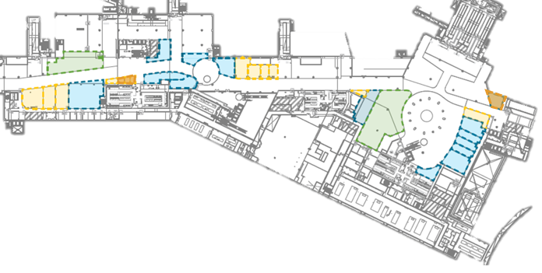
T6 Local Business Marketplace: Design & Construction
 | Local Business Marketplace
 | Specialty Retail & Travel Convenience
 | Food & Beverage
 | Duty Free

Slide 16
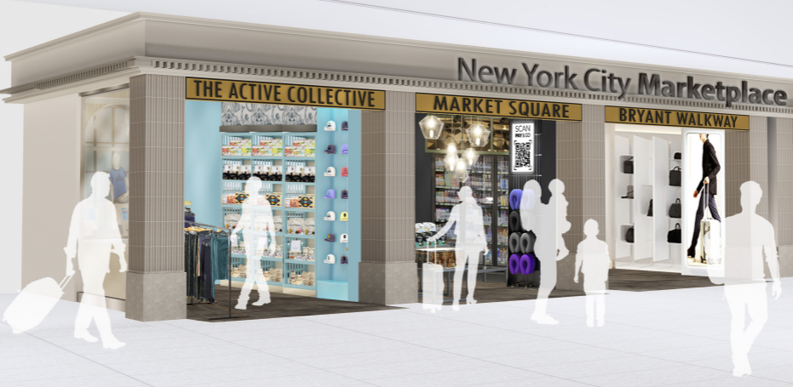
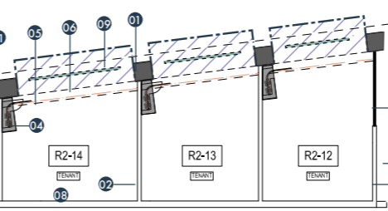
T6 Local Business Marketplace: Design & Construction
Phase 1 Selection Process is for R2-12 and two kiosks (not depicted here).
Kiosk design under development

Slide 17
T6 Local Business Marketplace: Marketing & Operational Support
JMP is committed to the success of our LBE & IOC members and will provide operational and marketing consultation services to each of our partners.
Operational Support
Marketing Support
Weekly touch-bases
Monthly business review meetings
Quarterly Marketplace meetings
Vantage will provide subject matter expertise to support specific business needs
Job Fairs for sourcing talented staff (Council of Airport Opportunity)
Connections to airport suppliers
Wayfinding
Events & promotions
Social media
Announcements in aviation industry & community media
Branding & visual presentation support
Merchandising support

Slide 18
T6 Local Business Marketplace Procurement Process

Slide 19
T6 Local Business Marketplace: Procurement Process & Timeline
3 Local Business Marketplace opportunities will be selected as part of this phase.
The process has been developed to reduce the cost and complexity for applicants.
Applications Open
2. Application Deadline
3. Award Notification
Applicants will be considered based on experience, concepts they may operate and financial ability to build and operate
After evaluating applications, JMP will inform applicants whether they will be invited to Stage 2 interviews.
After thorough evaluation of learnings based on the interview and an examination of brands JMP will award the 3 Phase 1 Marketplace opportunities.
Question Period Ends
Stage 2: Interviews
December 3, 2024
Begins March 2025
October 8, 2024
January 17, 2025
June 2025
Interested parties can submit questions to JMP through email beginning 10/8.
Answers will be compiled and published by JMP no later than 12/20.
Rolling notifications to preferred applicants to interview with members of the Procurement Evaluation Team.
*Subject to Port Authority Final Approval

Slide 20
Thank you

