Slide 1
JFK T6 IT Procurement Session
March 14th, 2025
Edward D’Angelo, Sr Director IT

Slide 2
Agenda
Background
Requirements & Evaluation Process
IT Systems Overview
CCTV / Lenel Access Control
Network, Wireless, VoIP
Enterprise Service Bus
Content Management System
Operational Systems
AODB (Airport Operational Database)
RMS (Resource Management System)
Self-Serve Kiosks
E-Gates
Biometrics
Architectural
Project

Slide 3
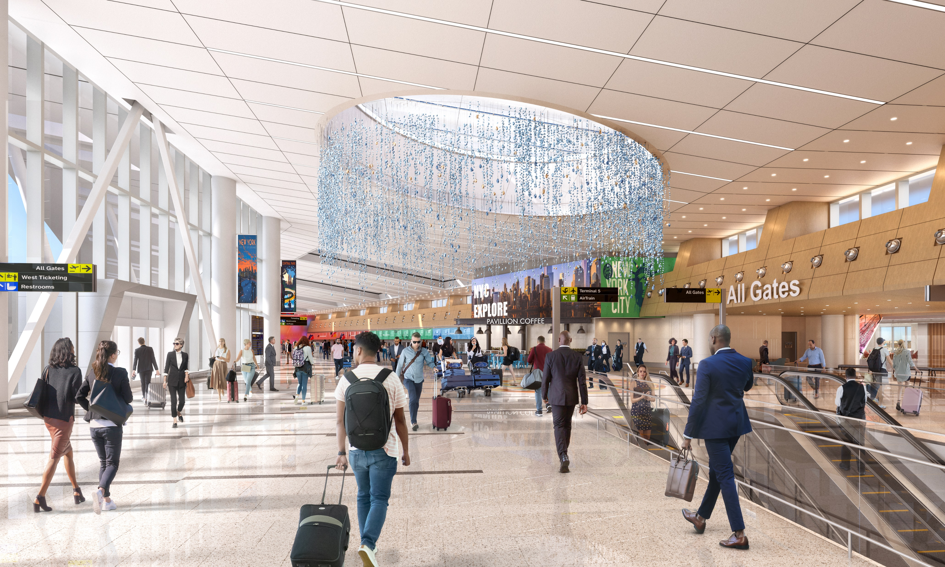
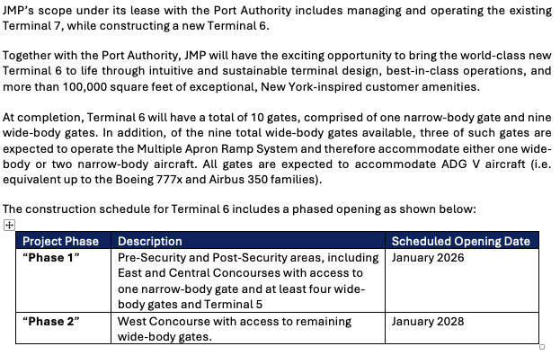
Background

Slide 4
Requirements & Evaluation Process
A. Bidder Requirements
(5) years experience supporting IT system to be bid on
Vendors must demonstrate experience in managing and maintaining Airport IT Systems in a high-traffic airport environment
Vendors must have the capability to provide 24/7 support, cybersecurity compliance, and scalable IT operations aligned with aviation industry standards
Evaluation:
6 JMP Team members including a member of executive team
(1) Outside Consultant (IT/LV discipline)
Evaluation criteria; cost, scope, team experience and key personal, company qualifications, MWBE participation and best overall value

Slide 5
IT Common Use Systems
Procurement:
RFP issued March 3, 2025
RFP Submission deadline April 18, 2025
Proposal Evaluation, Interviews, Negotiations Early April
Recommendation to Award – TBD
The selected Proponent will be responsible for the ongoing support, maintenance, staffing, and troubleshooting of the following IT systems for JFK Terminal 6:
SITA Airport Management System (AMS)
Common Use Passenger Processing (CUPPS)
Airline Connectivity (DCS)
(20) Self-Service Check-In Kiosk (SSCK)
(70) Self-Service Bag Drops (SSBD) and hybrid full CUTE set Check-in Positions - (software and server support for SSBD provided by Materna)
(5) BRS (Baggage Reconciliation Systems) IT Client Workstations (Break/Fix)
(15) E-Gates
Add/Alt
Multi-User Flight Information Display System (MUFIDS) – Break/Fix Terminal LED Displays (Software & back-end support to be provided by other)
Biometrics Platform for (2) touchpoints, SSBD & E-Gates (Specs and details to be delivered separately)

Slide 6
Network, VOIP, Wireless
Procurement:
RFP issued March 21, 2025
RFP Submission deadline May 9, 2025
Proposal Evaluation, Interviews, Negotiations Early April
Recommendation to Award – TBD
The selected Proponent will be responsible for the ongoing support, maintenance, staffing, and troubleshooting of the following IT systems for JFK Terminal 6:
IT Operations and Maintenance (O&M) framework that ensures the reliability, scalability, and efficiency of its Voice over IP (VoIP/Telephony), Local Area Network (LAN), and Wireless Network (802.11/WLAN), collectively known as “Systems” for the remainder of this solicitation. This framework includes both onsite and remote support solutions designed to support 24x7 operations.
The T6 LAN is designed to incorporate the following features or components and related subsystems or processes:
Core switches (Fortinet)
Distribution switches
Access switches
Routers
Firewalls
Operating Systems
End-point devices
Network management systems
VOIP Telephony (Cisco)

Slide 7
Security Systems - CCTV, Door Alarms, Intrusion
Procurement:
RFP issued March 21, 2025
RFP Submission deadline May 9, 2025
Proposal Evaluation, Interviews, Negotiations Early April
Recommendation to Award – TBD
Onsite (during regular business hours) and remote support for all security systems to be deployed at Terminal 6.
Security Services – CCTV Video Surveillance System (Verint)
Security Services – Access Control (Lenel)
Security Services – Intrusion Detection
The Intrusion Detection System at JFK T6 is designed to provided controls, sensors, detection devices, and communication links to perform physical security monitoring, alarm, and control functions.
The Video Surveillance System (VSS) at JFK T6 is comprised of two individual systems tightly integrated:
Management System (VMS), responsible for the storage and archiving of surveillance video, integration to all physical security subsystems, and user access to live and archived video, and (b) the Closed-Circuit Television (CCTV) consisting of an interconnected network of IP cameras and workstations/monitors, providing continuous video surveillance coverage throughout the Terminal.

Slide 8
Enterprise Service Bus
Procurement:
RFP issued March 21, 2025
RFP Submission deadline May 9, 2025
Proposal Evaluation, Interviews, Negotiations Early April
Recommendation to Award – TBD
The ESB at JFK T6 is designed to provide a standards-based integration platform to combine messaging web services, data transformation, and intelligent routing that connects and coordinates the interaction of diverse applications. The JFK T6 ESB will support and delivery a variety of key objectives including:
Application integrations
Data integration
Business-to-business (B2B) gateways
Application Programming Interface (API) and event enablement
Resource Coordination
Translation/transformation implementation
The T6 ESB is designed to incorporate the following features:
Data interchange standards
Data quality
Route messages between services across systems
Monitor and control routing of message exchange between services
API, Adapter management & enforcement
Resolve contention between communicating service components
Control deployment and versioning of services
Data interchange support

Slide 9
Content Management System
Procurement:
RFP issued March 21, 2025
RFP Submission deadline May 9, 2025
Proposal Evaluation, Interviews, Negotiations Early April
Recommendation to Award – TBD
The CMS at JFK T6 is designed to provide a content management platform that allows users to create, manage, and publish digital content such as airline branding, flight information, wayfinding, full motion artistic video, advertising, passenger queue times and other digital content, while adhering to cybersecurity controls. The CMS includes a full complement of onsite server headend equipment and edge devices, administrative workstations, mobile administrative GUI-based applications, and all related gateways and interfaces to related resource assignments from data sources as needed for successful system operation and integration.
The JFK T6 CMS will drive a variety of dynamic and static multimedia display content on numerous types of edge devices, including, but not limited to:
Check-in Ticketing Backwall
TSA Entry Portal Displays
TSA Instructional Displays
Large Custom FIDS at East Hall
Double Faced BIDS at Baggage Carousel – 6 Locations (12) Displays
Single Monitor Column Mounted BIDS Directory at FIS – (4)
Recessed EVIDS Display (FIDS or Directory Map) – (5)
Floor Mounted Single Faced EVIDS Display (FIDS or Directory Map) – (1)
Floor Mounted Single Faced EVIDS Display (FIDS or Directory Map) – 2 Locations
Floor Mounted Double Faced Stacked EVIDS Display (FIDS or Directory MAP) 3 Locations
Curbside Ticketing Identification Displays
Taxi Stand Rider Queue Displays -
Gate Portal Displays

Slide 10
Thank you

